Slide 1
Modeling PCOS
(Polycystic Ovarian Syndrome)
Matthew Cowen, Nolan Dahlman, Felicia Pursner, Nate Wilson
Advisor: Dr. Brandy Wiegers
CC-REU NSF summer REU experience (DMS-2050692)
Notes:
https://cwu.hosted.panopto.com/Panopto/Pages/Viewer.aspx?id=1df35d7a-251c-4479-8e83-aeec016260d7
https://cwu.zoom.us/j/8718445870
Introduced by Dr. B

Slide 2
Outline
Menstrual Cycle:
How PCOS affects it
Models for the Menstrual Cycle
Model for PCOS and Treatment

Slide 3
Menstrual Cycle
1
What it is and how PCOS affects it
Notes:
Matt

Slide 4
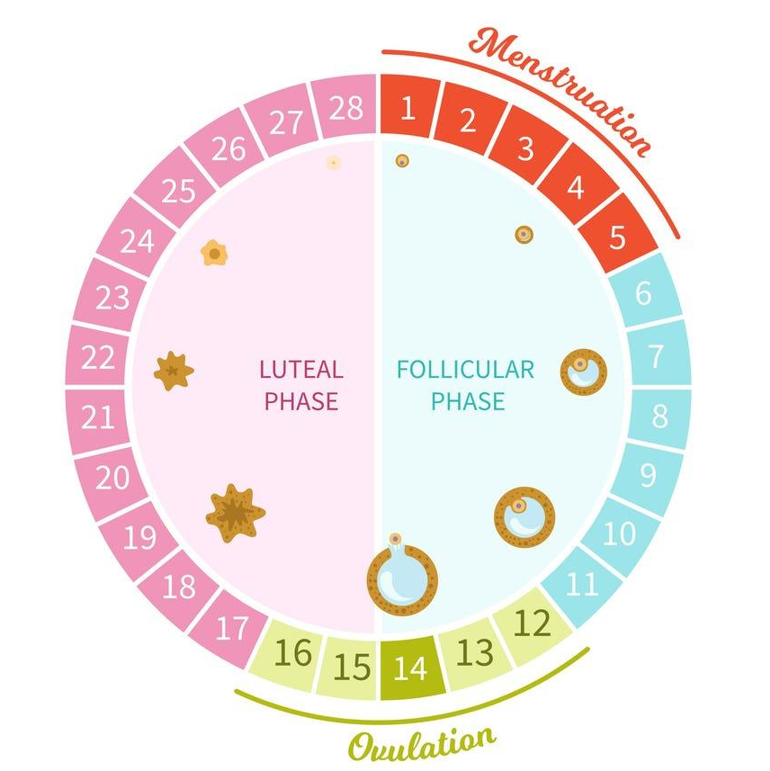
The Menstrual Cycle Phases
The luteal phase begins once ovulation occurs (when the follicle ruptures), then the corpus luteum forms.
The follicular phase is defined by menstruation and dominant follicle growth.
Notes:
Introduction of menstrual cycle - different stages, not the Follicular and Luteal phase
Note where ovulation happens
MATT
Matt

Slide 5
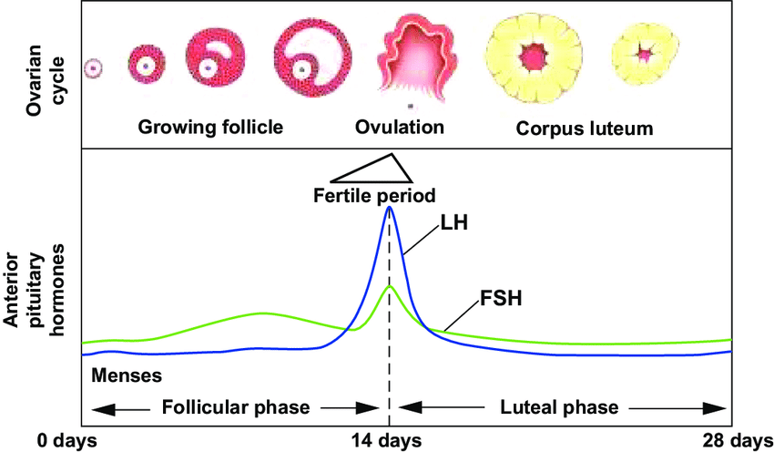
Active Hormones
Follicle Stimulating Hormone (FSH) spikes twice
Luteinizing Hormone (LH) spikes once before ovulation.
Notes:
More depth of what is happening on that phase - what happens during ovulation
What corpus luteum is, and that stuff
MATT

Slide 6
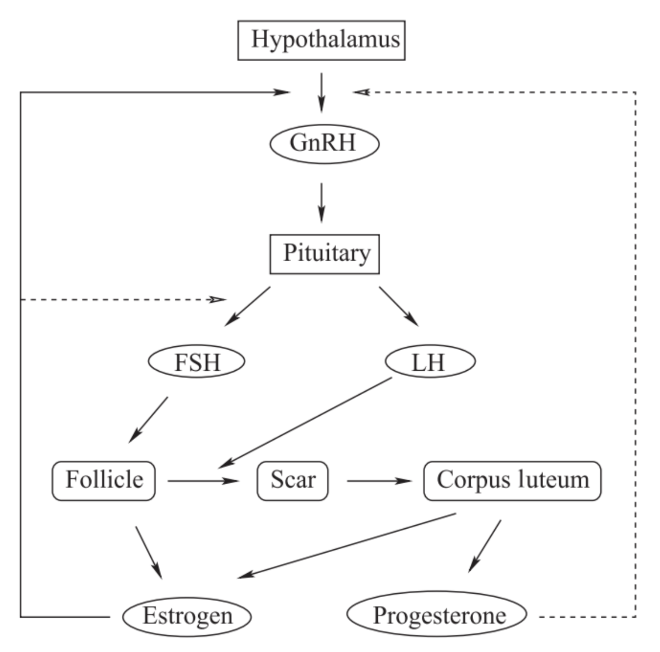
Hormone System
Connects the brain and the ovaries
Positive feedback loop
Notes:
Felicia
The connection between the brain and the hormones - brain releases FSH/LH. THe pulse of GnRH - show that all the hormones occur in a feedback/cyclic manner

Slide 7
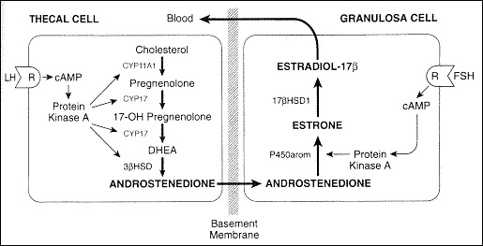
Two-Gonadotropin Hypothesis
Estradiol → Progesterone →
LH → Androgen
Estrogen
Aromatization
Testosterone
Testosterone
Notes:
Felicia
FSH sent from pituitary to produce estrogen in the granulosa cell
This stimulates progesterone to trigger a positive feedback loop in the pituitary to send LH
LH binds to produce androgen in the theca cell
Androgen passes the membrane to be aromatized to estrogen again (creating a loop)

Slide 8

Polycystic Ovarian Syndrome
PCOS is defined by the presence of ovarian cysts in ovulating patients. Other symptoms include excess testosterone and anovulatory infertility.
Notes:
Felicia
Introduce PCOS - explain what might occur, will come back later

Slide 9
Modeling
2
Why we made it and how it works
Notes:
Nate

Slide 10
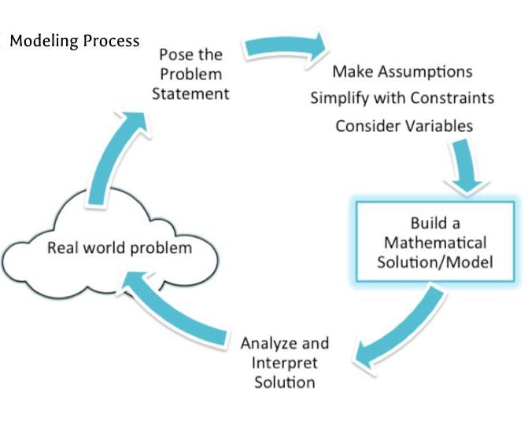
Why use a Mathematical Model?
Allows for variation of inputs to produce desired outcomes
Provides visual representation of problem(s)
Solves real world problems accurately and efficiently with use of powerful computing
Notes:
Nate
Describe what a mathematical model is - how it flows/works together. Should be quick

Slide 11
OUR MODELS
Chen and Ward Model
Construct PCOS Model using Hendrix Model
Our PCOS Model: Adding Testosterone and Insulin
Test Metformin on PCOS Model
Notes:
Matt
10-15 secs
Outline: This illustrating the models that we’ve looked at - introduce PCOS model that we’ll end on

Slide 12
Starter Model: Chen and Ward Model (2013)
Differential Equations:
Change in masses of the follicle, rupturing follicle, and corpus luteum
Auxiliary Equations:
Hormone concentration of FSH, LH, GnRH, Progesterone, and Estrogen
The Chen and Ward Model consists of 3 differential equations and 5 auxiliary equations.
Notes:
Matt
Describe what a mathematical model like this (with differential equations) would look like

Slide 13
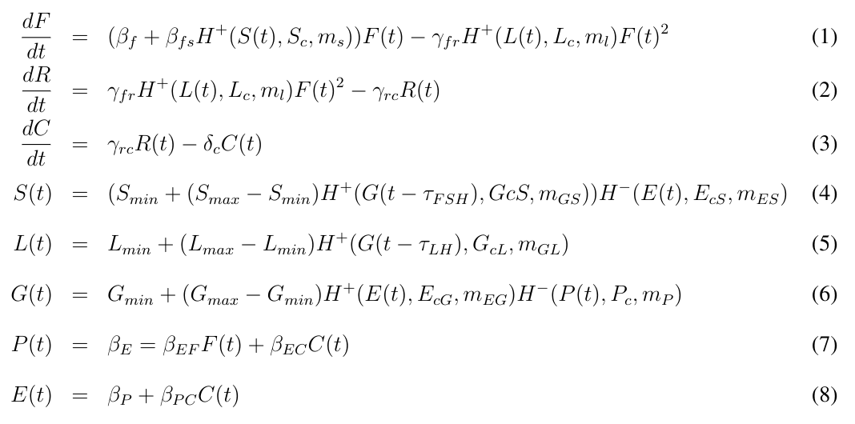
Chen and Ward Model
Differential Equations
Auxiliary Equations
Notes:
Matt
Explaining the closed diff-eq system - showing how it’s balanced between equations
Provide as an example

Slide 14
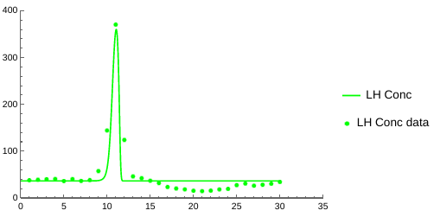
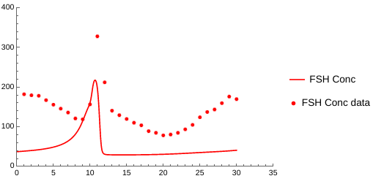
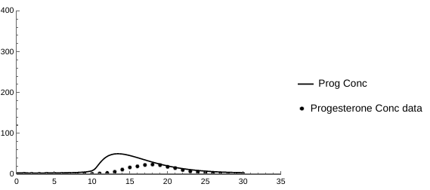
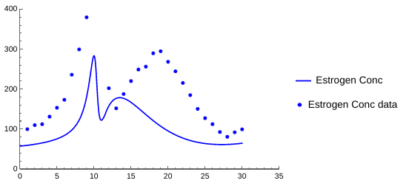
Chen and Ward Model
Notes:
Matt

Slide 15
OUR MODELS
Chen and Ward Model
Construct PCOS Model using Hendrix Model
Our PCOS Model: Adding Testosterone and Insulin
Test Metformin on PCOS Model
Notes:
Nate
10-15 secs
Outline: This illustrating the models that we’ve looked at - introduce PCOS model that we’ll end on

Slide 16
Hendrix Model (2013)
Differential Equations:
Change in mass of follicle, ruptured follicle, and corpus luteum during cycle
Auxiliary Equations:
Hormone concentration of FSH, LH, Progesterone, Estrogen, and Testosterone
The Hendrix model consists of a system of 16 delayed differential equations and 5 auxiliary equations.
Notes:
Nate
Final model was built off this as a base model - more complex than Chen Ward, could be added onto to better model PCOS
Very similar to biological system - most biologically accurate

Slide 17
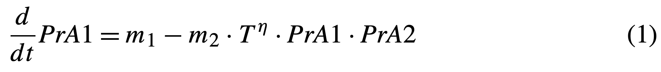
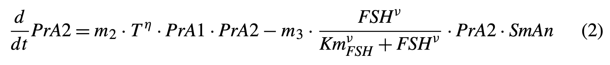
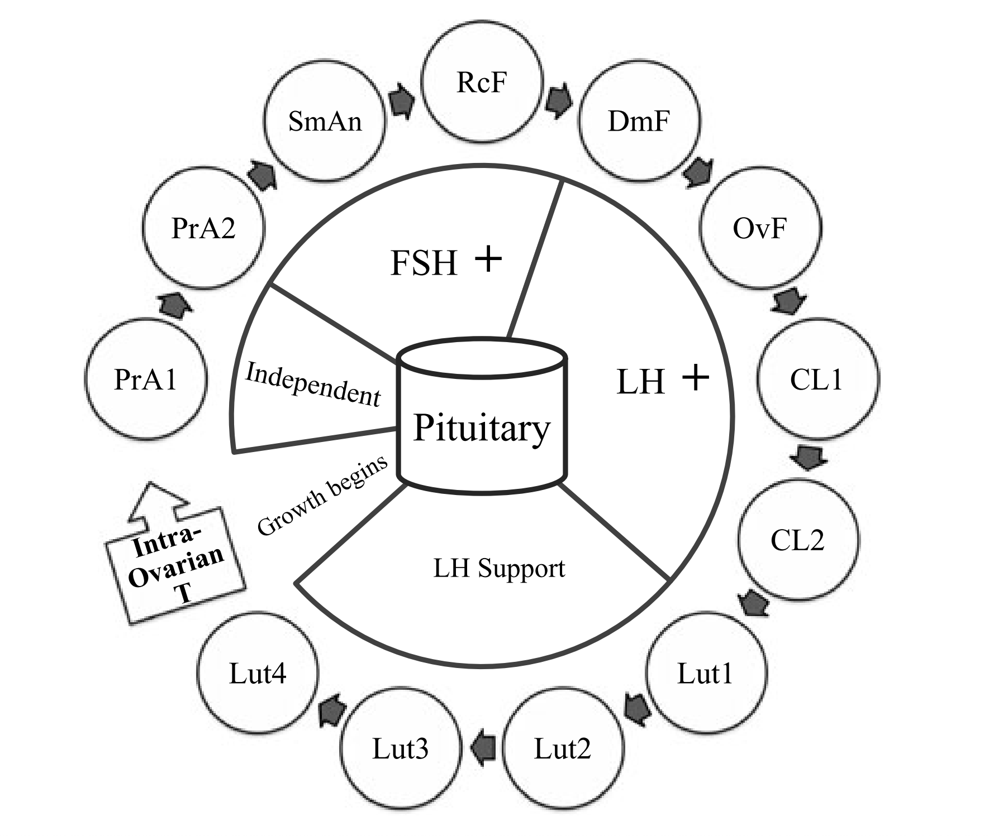
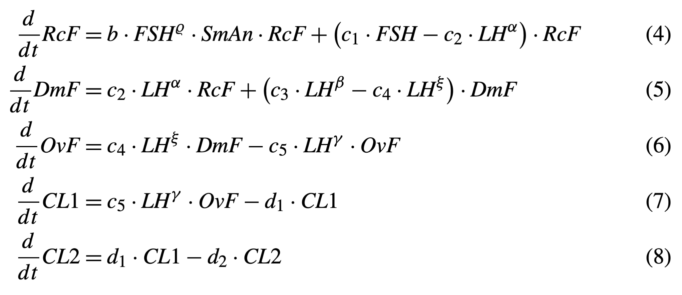
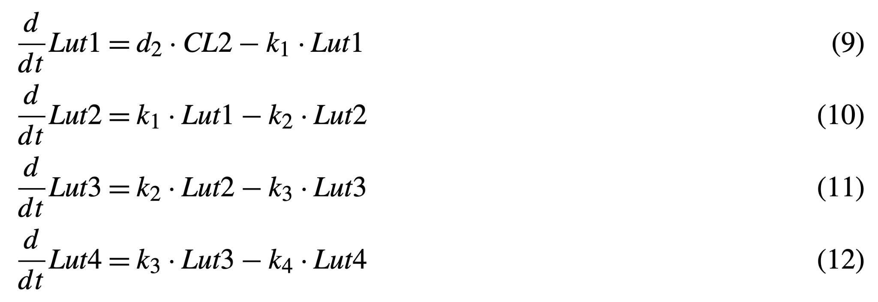
Hendrix Model
Menstrual Cycle
(1)
Figure from: Modeling Endocrine Control of the Pituitary–Ovarian Axis: Androgenic Influence and Chaotic Dynamics - Angelean Hendrix, et al.
Notes:
Nate
More complex than Chen Ward, still system of delayed differential equations - cycle - see picture

Slide 18
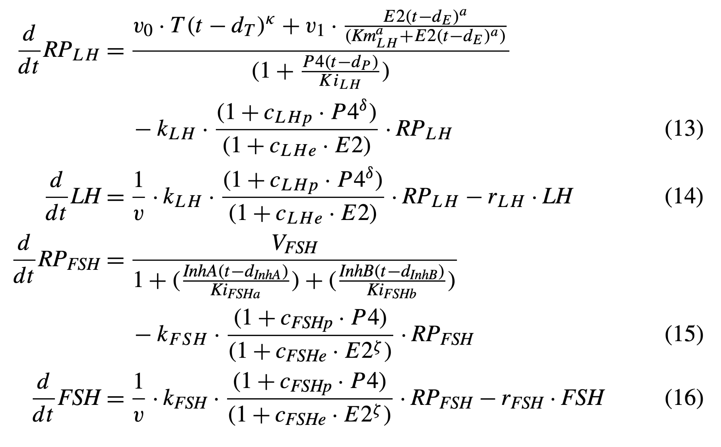
Hendrix Model
Menstrual Cycle
Figure from: Modeling Endocrine Control of the Pituitary–Ovarian Axis: Androgenic Influence and Chaotic Dynamics - Angelean Hendrix, et al.

Slide 19
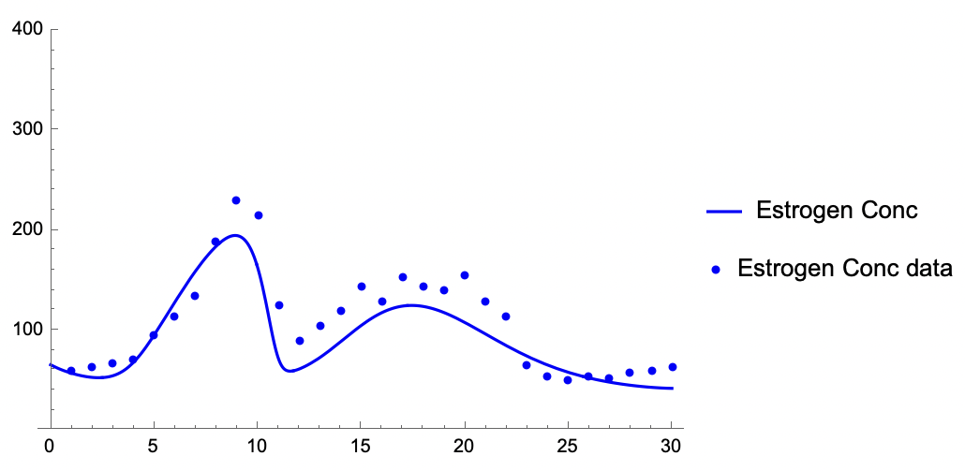
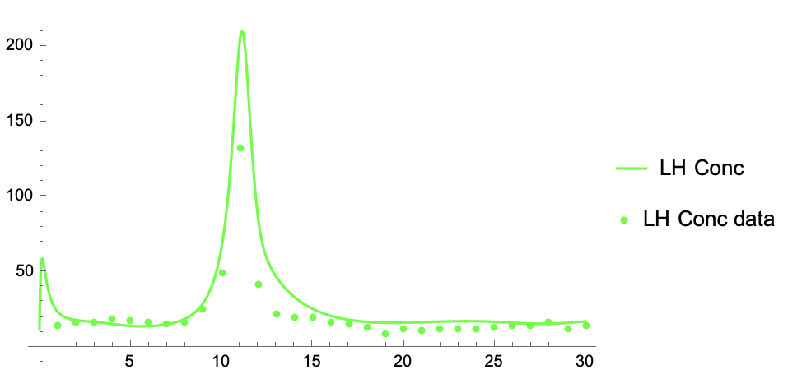
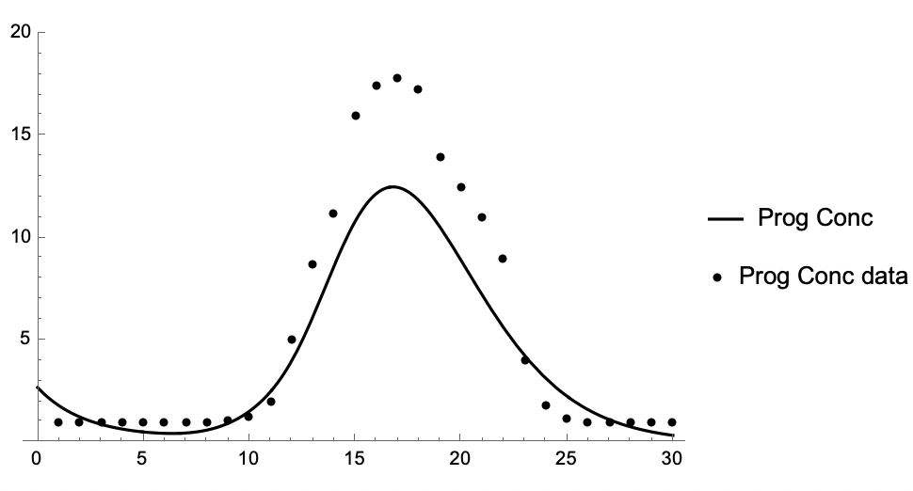
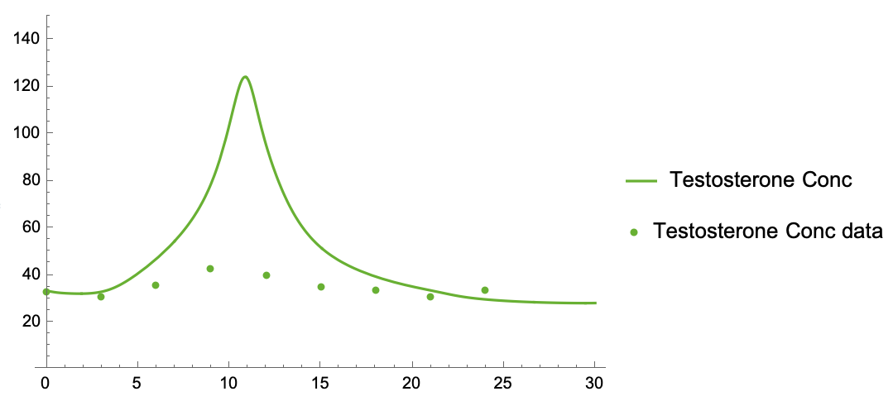
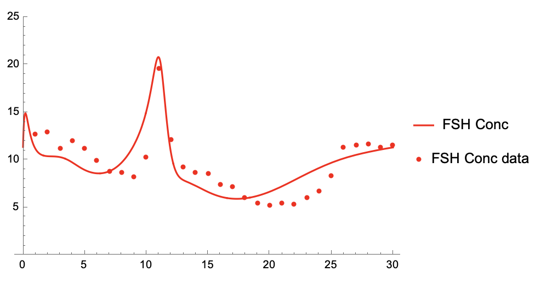
Hendrix Model
Notes:
Nate
Reinforce biologically accurate - real data vs model results

Slide 20
OUR MODELS
Chen and Ward Model
Construct PCOS Model using Hendrix Model
Our PCOS Model: Adding Testosterone and Insulin
Test Metformin on PCOS Model
Notes:
Nolan
10-15 secs
Outline: This illustrating the models that we’ve looked at - introduce PCOS model that we’ll end on

Slide 21

Insulin Resistance
Treat PCOS as type two diabetes
Luteal phase insulin resistance due to Progesterone increase causes insulin resistance to increase
Rhythmic cycling in menstrual cycling
Notes:
Nolan
Here is one of the symptoms of PCOS that we focused on - PCOS can be derived from insulin resistence. Why hormone imbalance contribute to these things through insulin resistence

Slide 22
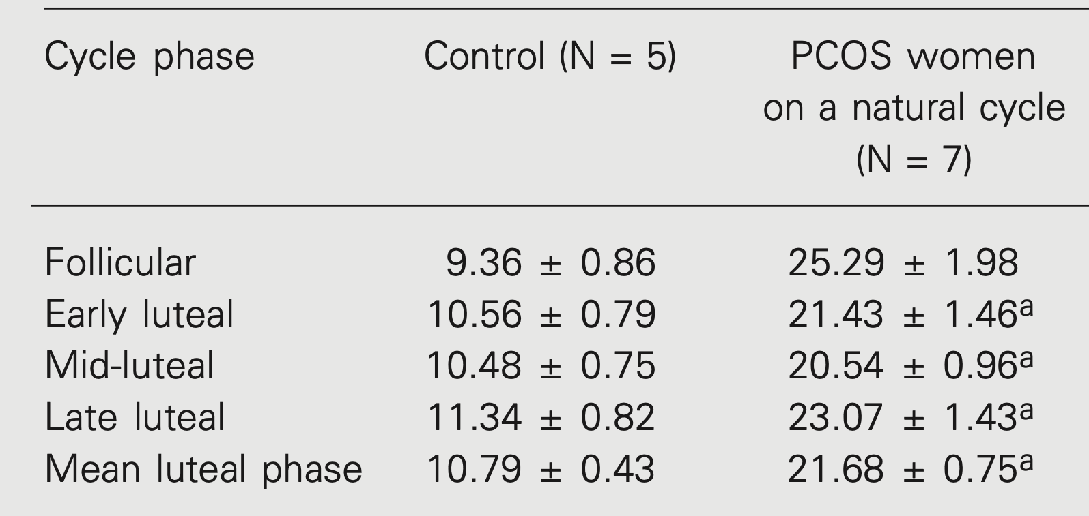
Modeling Insulin
We used Mennakumar et al. data of Insulin during the menstrual cycle
Notes:
Nolan

Slide 23
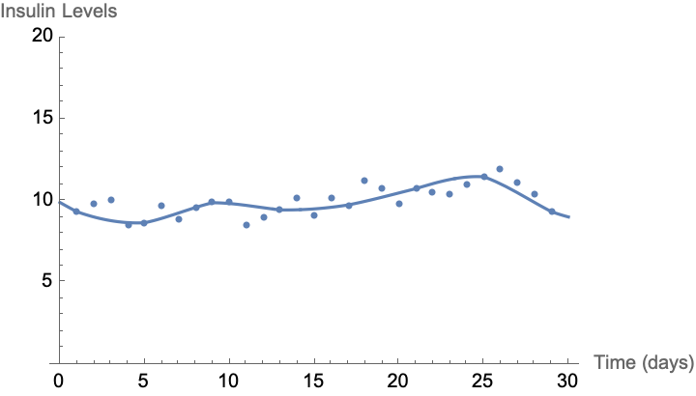
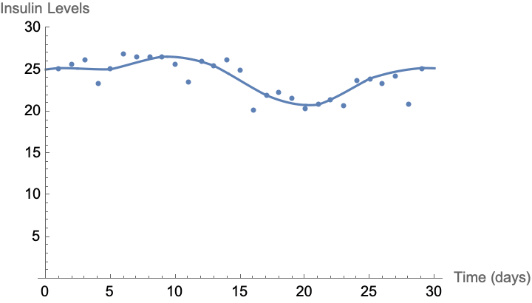
Modeling Insulin
Hermite Interpolation for Control Insulin
Hermite interpolation for PCOS Insulin
Notes:
Nolan

Slide 24
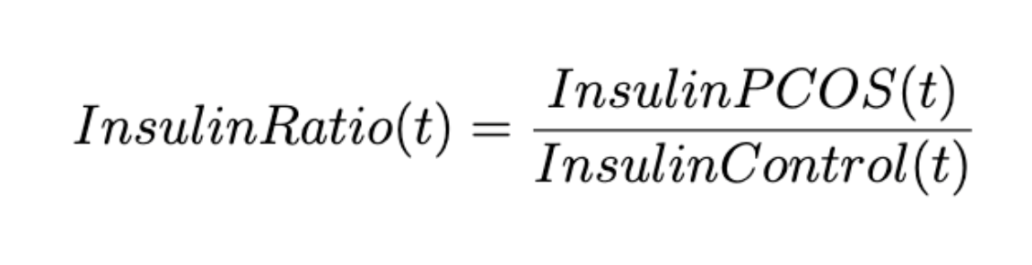
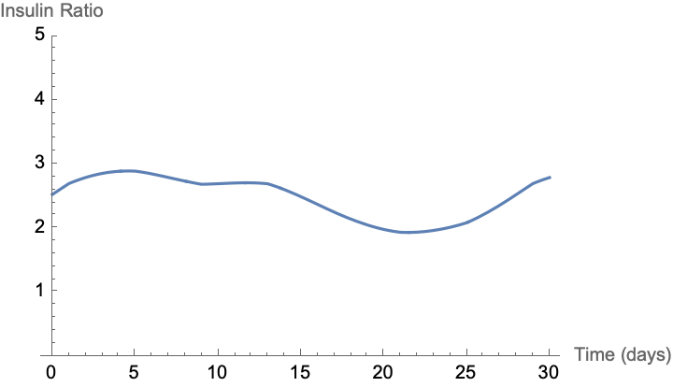
The Insulin Ratio
After making an equation like this we have a cyclic model for insulin increase in PCOS patients
Notes:
Nolan

Slide 25
PCOS Model
Differential Equations:
Change in mass of follicle, ruptured follicle, and corpus luteum w/ Insulin added
Auxiliary Equations:
Hormone concentration of FSH, LH, Progesterone, Estrogen, and Testosterone w/ Insulin added
The PCOS model consists of the same 16 differential and 5 auxiliary equations from Hendrix, but with the addition of an equation and parameter changes to better fit PCOS.
Notes:
Should we talk about increased insulin in PCOS Here? Or will we just have these changes be effects of PCOS and say later that this could be because of high insulin levels. Kind of hard to talk about these things without mentioning Insulin at some point.
Describe what we’ve done to add insulin into the Henrdix model. Should be a quick slide.
Setup for next few slides to see that Insulin is impacting the whole system - indicate with blue color????>>>

Slide 26
What Does Increased Insulin do to Hormones?
More Insulin means a higher pulse of GnRH
LH levels will be higher
FSH levels will be similar
Notes:
So

Slide 27
What Does an Increase In LH mean for Other Hormones?
From Khashchenko, Elena et al. we see FSH levels remain the same
There is an increase in the ratio of LH:FSH (From 0.7 → 1.6 possibly higher)
More Androgens are being created than can be converted to Estrogen

Slide 28
Increased Androgens?
Increase in Androgens DO NOT increase Estrogen production
Insulin decreases aromatase’s ability to convert Androgens to Estrogen
Leaving Androgens high and Estrogen Low

Slide 29
What Do we Expect to See with an Increase in Insulin?
Increase in:
GnRH Pulse
LH
Testosterone
Similar in:
FSH
Decrease in:
Estrogen
Progesterone
Notes:
So in summary, starting with the Insulin’s GnRH pulse, this is the impact we should see in the resulting model

Slide 30
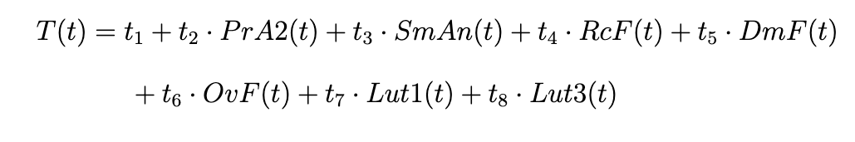
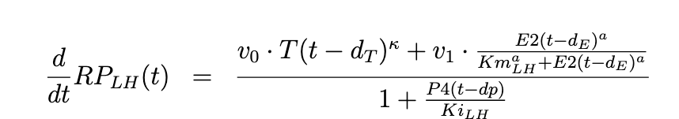
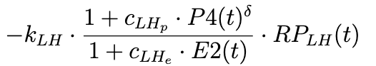
The Parameters Changed
Notes:
List of parameter changes we did - showing in context of the equations
We can explain more in the Q&A, these are the things the biology told us to change

Slide 31
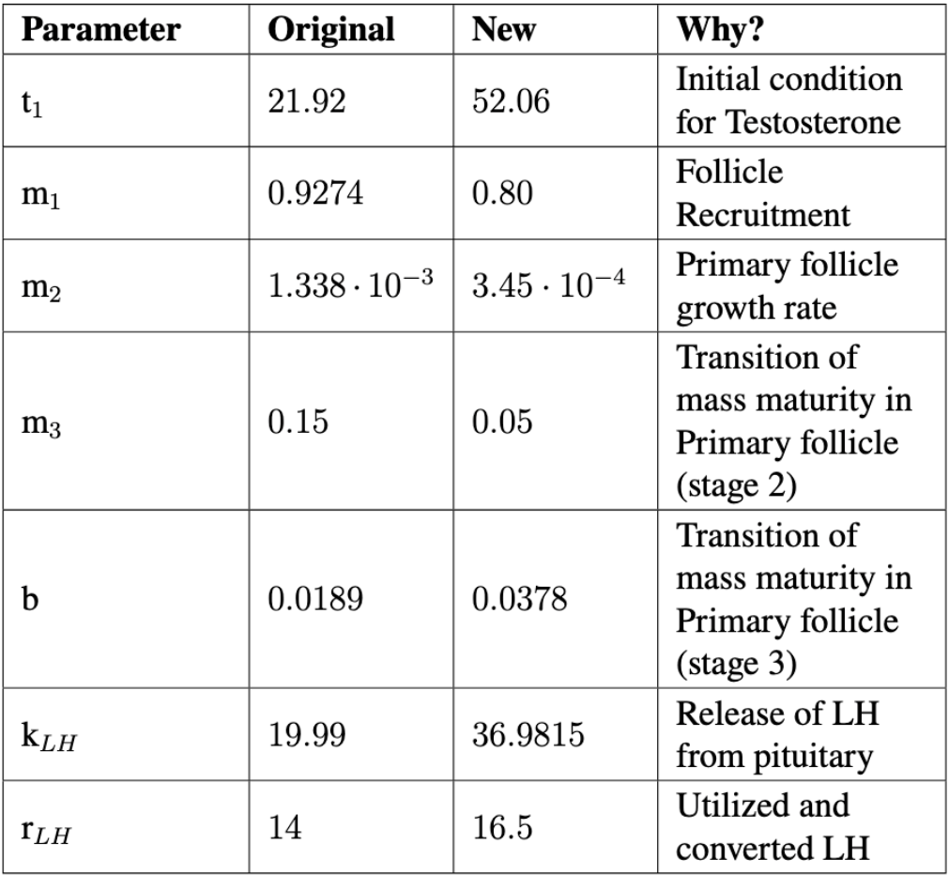
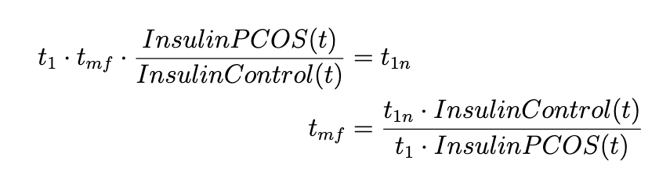
Incorporating The Insulin Ratio: Parameter Example
We want to add the insulin ratio equation to all the parameters

Slide 32
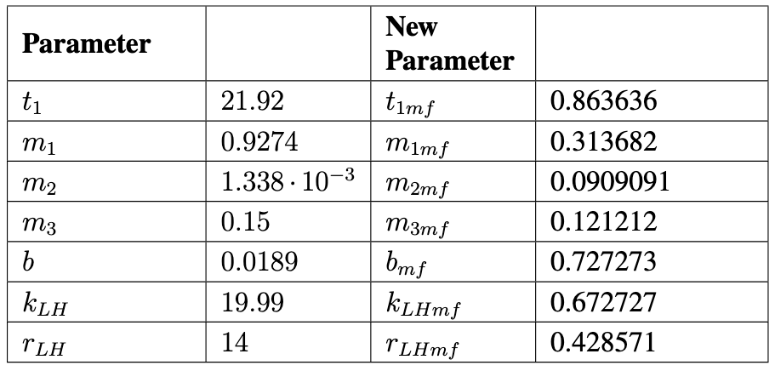
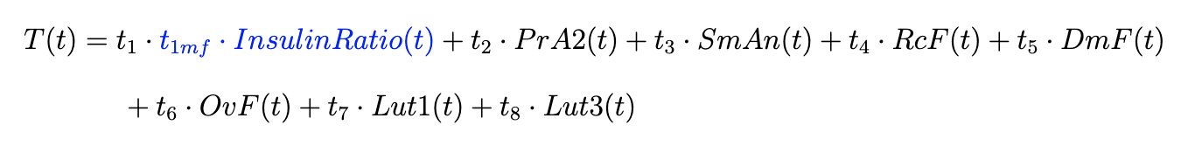
Incorporating The Insulin Ratio
Old Equation
New Equation

Slide 33
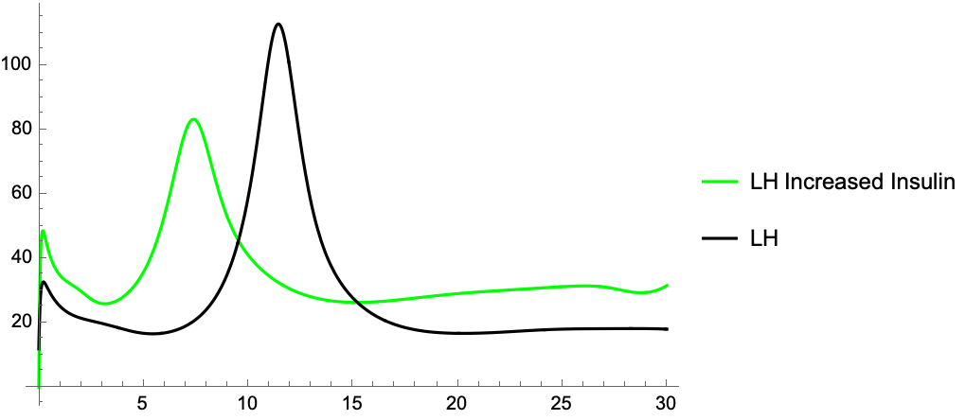
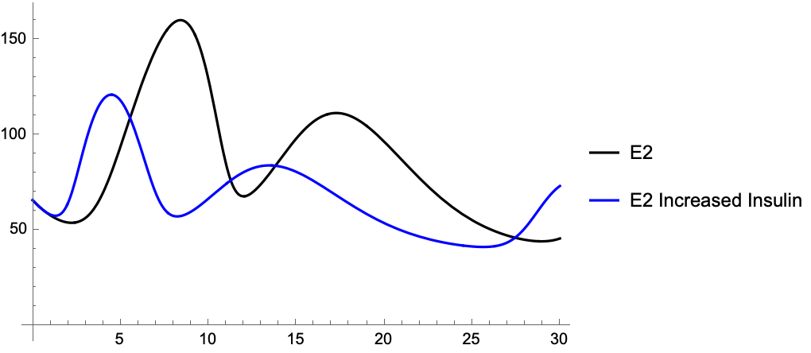
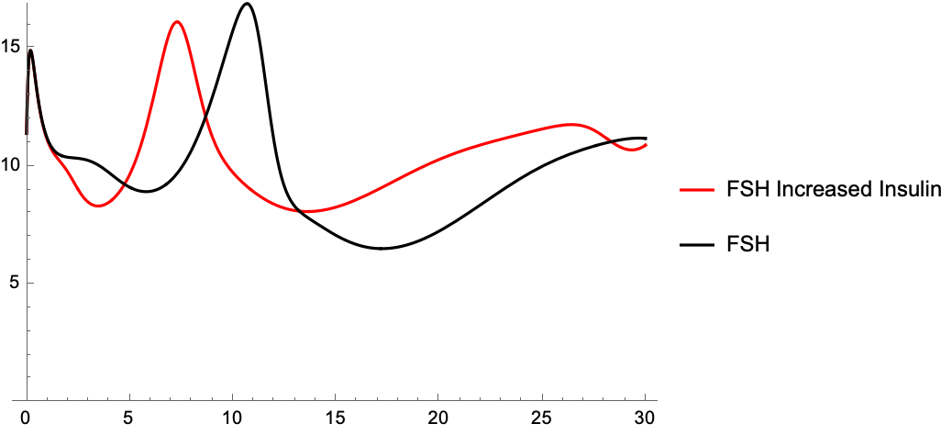
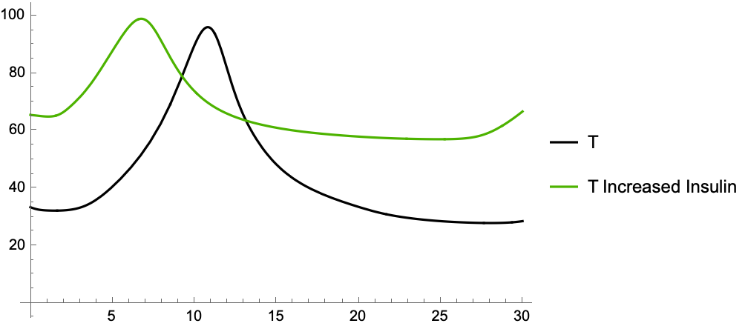
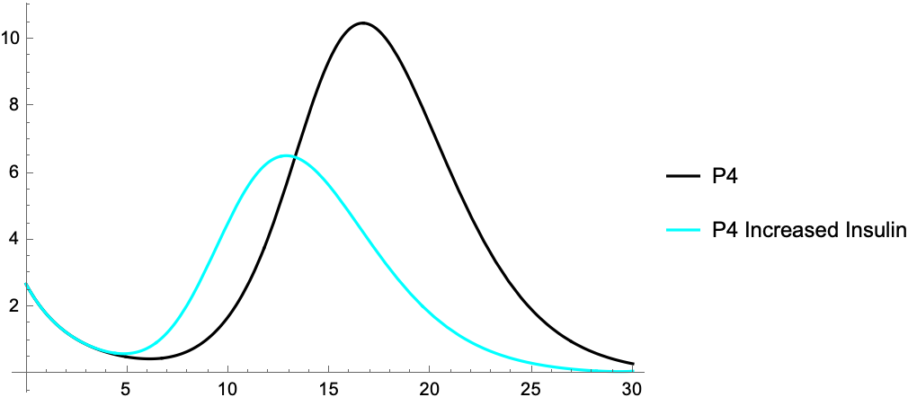
Insulin Model with Changed Parameters
Increase
Decrease
Similarity
Notes:
Resulted in the following model
Overall increase

Slide 34
Treatment
3
How it affected the PCOS model
Notes:
Nate

Slide 35
Treating PCOS
Typical Treatment: Birth Control
Rebalance hormones
Clears acne
Reduces hair growth
Prevents pregnancy
Many options available
Our Treatment: Metformin
Used for Type II Diabetes
Lowers insulin and androgen levels which can lower BMI
High BMI causes hormones to be unbalanced
Can be pregnant due to ovulation
Not a prescription for PCOS

Slide 36
OUR MODELS
Chen and Ward Model
Construct PCOS Model using Hendrix Model
Our PCOS Model: Adding Testosterone and Insulin
Test Metformin on PCOS Model
Notes:
Nate
10-15 secs
Outline: This illustrating the models that we’ve looked at - introduce PCOS model that we’ll end on

Slide 37
Metformin as a Treatment
The goal is to return insulin levels to normal using Metformin as a treatment
Therefore adding metformin to our equations will reduce the insulin ratio closer to 1:1
Values around 10 ng/mL (Control)
Values around 25 ng/mL (PCOS)

Slide 38
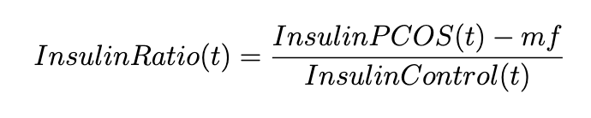
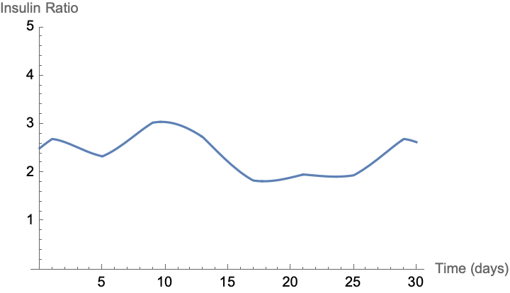
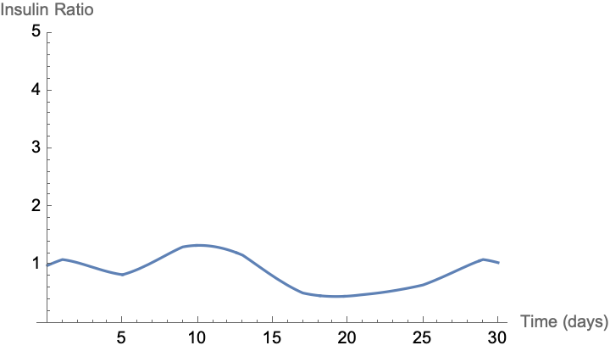
Metformin as a Treatment: Insulin Ratio
We have 15 ng/mL of range with Metformin’s efficiency
Mf = 0
Mf = 15
Notes:
How metformin (mf) is involved in the equation

Slide 39
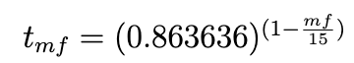
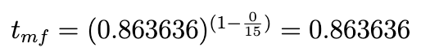
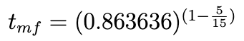
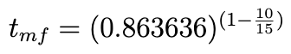
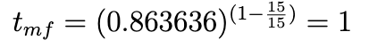
Metformin as a Treatment: Parameters
One of the main concerns is returning the parameters
back to the Hendrix Model parameters
Mf = 0
Mf = 5
Mf = 10
Mf = 15
Notes:
How we adjusted the parameters so that they’d start at value with mf = 0 and go to 1 as mf is increased

Slide 40
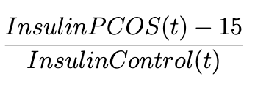
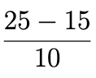
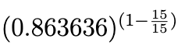
Metformin as a Treatment: How it looks in Equations
As we increase Metformin, the two added parameters
1
1

Slide 41
Metformin Graphs: mf = 0
Notes:
Seen this previously

Slide 42
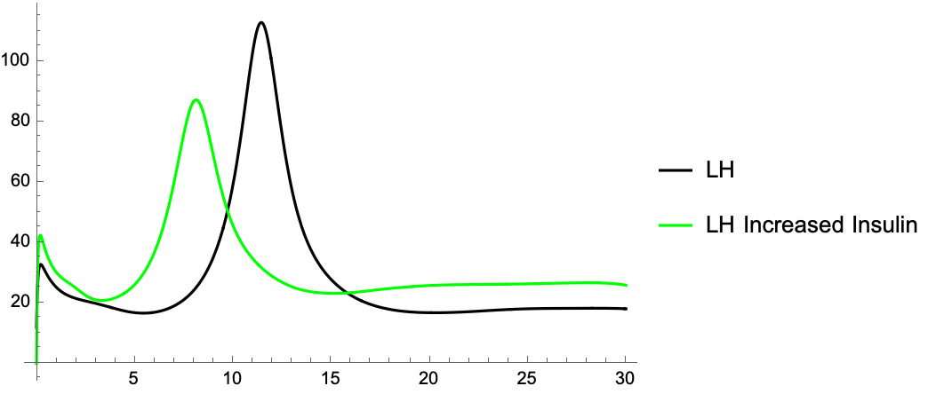





LH as Metformin is Increased
Mf = 5
Mf = 10
Mf = 15
Notes:
Nearly the same LH graph as MF increases, nearly lined up

Slide 43
Future Improvements
Figure out more optimal parameter changes and implement them
Make sure parameters that changed got implemented correctly
Notes:
Acknowledge room for improvements

Slide 45
Future Work
Figure out more optimal parameter changes and implement them
Build a system of differential equations to model Insulin
Replace Insulin Ratio with modeled Insulin
Incorporate more symptoms and treatments of PCOS
Better PCOS data → better model

Slide 46


References

Slide 47
THANK YOU!
Contact DahlmanN@cwu.edu for questions
Matthew Cowen, Nolan Dahlman, Felicia Pursner, Nate Wilson
Advisor: Dr. Brandy Wiegers
This presentation summarized the results of the CC-REU NSF summer REU experience (DMS-2050692)

Slide 48
1. Dr Brandy
2. Matt
3. Matt
4. Matt
5. Felicia
6. Felicia
7. Felicia
8. Nate
9. Nate
10. Matt
11. Matt
12. Matt
13. Matt
14. Nate
15. Nate
16. Nate
17. Nate
18. Nolan
19. Nolan
20. Nolan
21. Nolan
22. Nolan
23. Felicia
27. Felicia
30. Felicia
31. Felicia
32. Nate
33. Nate
34. Nate
35. Nolan
36. Nolan
37. Nolan
38. Nolan
39. Matt
40. Matt
43. Nate
44. Nate
45. Nate
Matt: 9
Felicia: 7
Nate: 12
Nolan: 9

Slide 49
Treatments for PCOS
Type II diabetes medicine
Lowers insulin and androgen levels
Lowers BMI
Solves the root problem
Metformin
Options
Rebalance hormones
Clear acne
Birth Control
Lifestyle Changes
Normalize hormones
Improve insulin use
Lower BMI
Diet changes
Infertility
Lower BMI
Clomiphene
IVF
Surgery
Notes:
Nate
Highlight main PCOS treatments, quick slide
Highlight metformin
Metformin is NOT the common treatment, BCP is

Slide 50
Treatments for PCOS
Normalize hormones
Improve insulin use
Lower BMI
Diet changes
Lifestyle Changes
Lower BMI
Clomiphene
IVF
Surgery
Infertility
Birth Control
Options
Rebalance hormones
Clear acne
Metformin
Type II diabetes medicine
Lowers insulin and androgen levels
Lowers BMI
Solves the root problem
Notes:
Nate
Highlight main PCOS treatments, quick slide
Highlight metformin
Metformin is NOT the common treatment, BCP is

